Slide 1
Programming pradgism - Functional programming -
Functor, Monad and Applicative

Slide 2
0. Typeclass
Typeclass take role in type system as Interface in OOP.
Example: A typeclass that defind ‘==‘ operator.
class Eq a where
(==) :: a -> a -> Bool
(/=) :: a -> a -> Bool
x == y = not (x /= y)
x /= y = not (x == y)
Type parameter

Slide 3
0. Typeclass
data TrafficLight = Red | Yellow | Green
instance Eq TrafficLight where
Red == Red = True
Green == Green = True
Yellow == Yellow = True
_ == _ = False
Make type TrafficLight can be compared

Slide 4
0. Excercise
Define:
instance Eq (Maybe m) where
…
What different between:
instance Eq (Maybe m) where
and
instance (Eq m) => Eq (Maybe m) where

Slide 5
1. Functor
A functor is an abstract type that is being appliable.
class Functor f where
fmap :: (a -> b) -> f a -> f b

Slide 6
1. Functor List
List is a functor.
instance Functor [] where
fmap = map
map :: (a -> b) -> [a] -> [b]
ghci> fmap (*2) [1..3]
[2,4,6]

Slide 7
2. Functor Maybe m
(Maybe m) is also a Functor
instance Functor Maybe where
fmap f (Just x) = Just (f x)
fmap f Nothing = Nothing

Slide 8
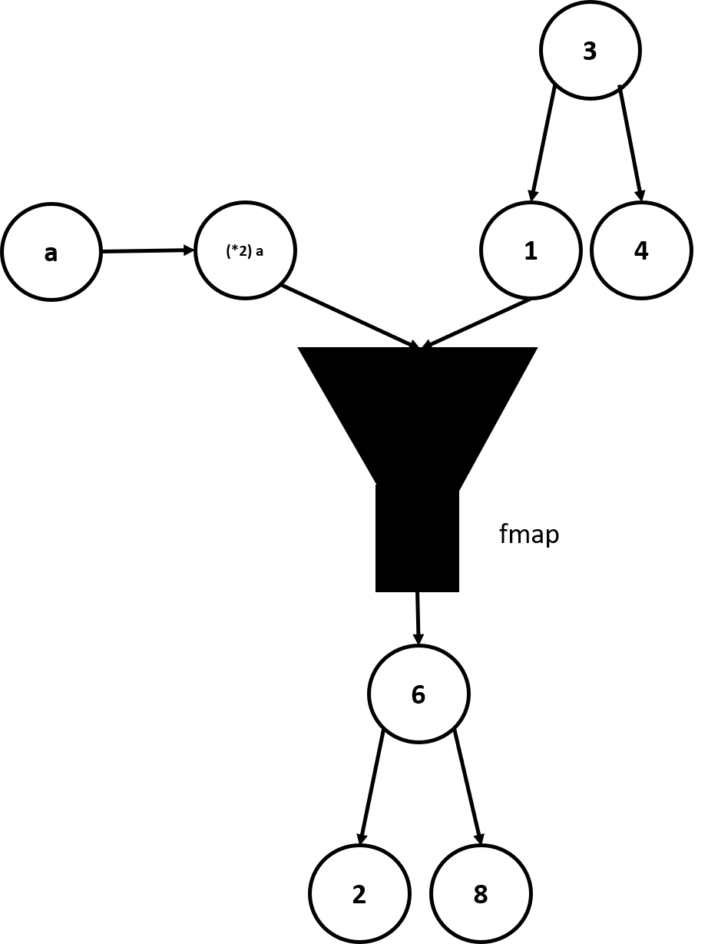
3. Functor Tree
instance Functor Tree where
fmap f EmptyTree = EmptyTree
fmap f (Node x leftsub rightsub) = Node (f x) (fmap f leftsub) (fmap f rightsub)

